Slide 1
AM Flexproof 505 ECO PU – Waterproofing Coating
DESCRIPTIONS
AM Flexproof 505 ECO PU is a flexible; single
component; low VOC; water based acrylic
polyurethane hybrid waterproofing and sealing
membrane. AM Flexproof 505 ECO PU is a fast drying waterproofing membrane with excellent adhesion to wide range of substrates, providing a long lasting waterproofing.
FEATURES/BENEFITS
Excellent adhesion to wide range of substrates
High durability
Excellent UV and water resistance
Environmental Friendly; non–toxic & low–odour
Tough flexible film
Fast drying and easy to clean
FIELD OF APPLICATIONS
Rooftops
Balconies and terraces
Planter boxes and flowerbeds
Interior and exterior of concrete walls
SPECIFICATION
ⱡ Dry time may varies depending on existing concrete conditions, weather and humidity.
ⱡⱡ Coverage may vary depending on the porosity of the substrates
Appearance | Viscous Liquid
Nature | Single Component
Solid Content | > 60%
Elongation at Break (ASTM D412:2006a) | > 300%
Tensile Strength (ASTM D412:2006a) | > 2.1 N/mm²
Adhesion Strength (ASTM D4541:2002) | > 1.9 N/mm²
Shore A Hardness (ASTM D2240:2005) | > 75
Crack Bridging (ASTM C836:00)
Method A – Widening of crack width till 3mm | No Crack
Method B – Stretching and closing to a width of 1mm | No Crack
Re-Coat @ 25ºC | 2 - 3 hours
Full Cure @ 25ºC | 3 days
Estimated Coverage | 5-7m² /kg
Recommended Dry Film Thickness (DFT) Per Coat | 0.25-0.3mm (Wall) 0.35-0.5mm (Roof)
Density | 1.35g/cm³

Slide 2
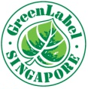
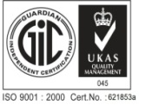
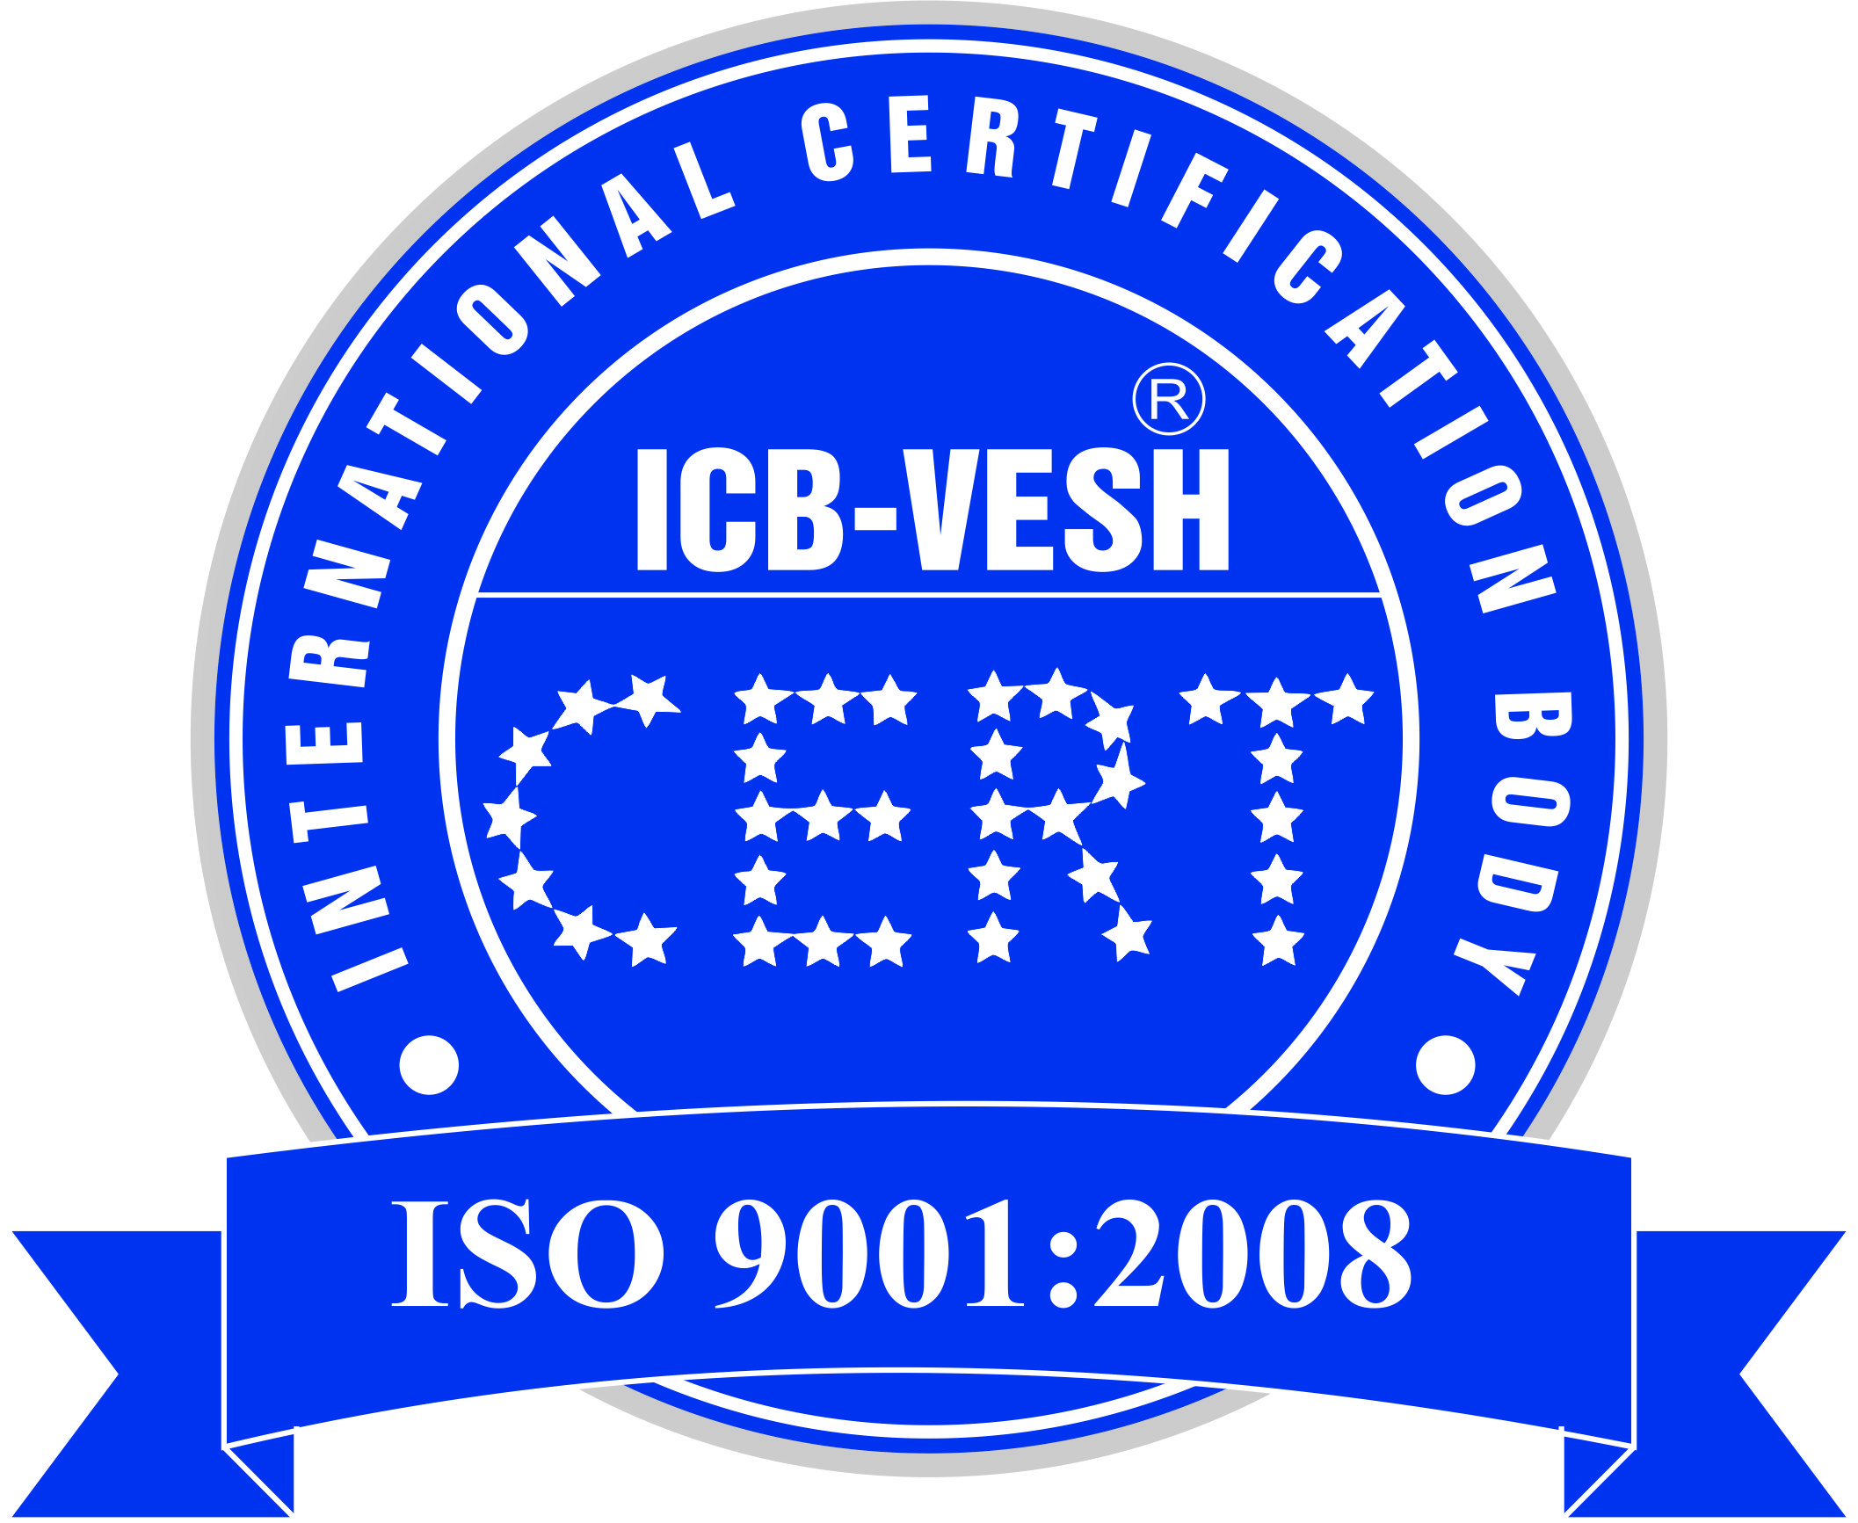
METHOD OF USE
Surface Preparation
All new concrete must be allowed to cure for a
minimum of 28 days. New render / screed
surfaces must be allow to cure for at least 7 days.
Old concrete / render / screed surfaces need to be
cleaned, dry and sound, free of any contamination
that may affect the adhesion of the membrane
Prime the surfaces with PU-Cote 408P Primer
prior to applying AM Flexproof 505 ECO PU.
All metal surfaces must be totally free of rust.
Prime metal surfaces with anti-rust primer prior to
applying AM Flexproof 505 ECO PU
All cracks should be repaired with suitable putty
and smoothen surfaces with sandpaper prior to
applying AM Flexproof 505 ECO PU. Hairline crack with up to 1mm wide, may be duly fill with
AM Flexproof 505 ECO PU.
All expansion joints and perimeter joints should be
sealed with bond breaker tape prior to application
of AM Flexproof 505 ECO PU.
Application
Stir well before apply. Apply AM Flexproof 505 ECO PU evenly at recommended coverage rates.
Apply with roller, brush or airless spray gun.
Reinforcement of fibreglass fabric may be use to
enhance high tolerance to normal substrate or
crack movement, hence protecting against
membrane rupture. Ensure fibreglass fabric is
applied into wet coat of AM Flexproof 505 ECO PU membrane and then covered over with
subsequent coating until it is not visible.
Allow 2 to 3 hours for each coat to cure before
applying subsequent coat.
CLEANING
AM Flexproof 505 ECO PU can be easily clean with soap and water.
LIMITATIONS
Do not use at areas subject to negative
hydrostatic pressure or rising dampness.
HANDLING
AM Flexproof 505 ECO PU should be stored in a dry place under shade, free from moisture contact.
PACKAGING
AM Flexproof 505 ECO PU – 20 Litres / Pail
SHELF LIFE
Up to 12 Months in unopened containers, when stored in a cool, dry place
HEALTH & SAFETY
Only use AM Flexproof 505 ECO PU as directed. Always ensure Safety Data Sheets are carefully read prior to the application of the materials. Protective clothing, gloves, eye protection & respirators must be worn at all times during application. Please consult & follow all instructions on the product Safety Data Sheets for detailed
TECHNICAL & SITE SUPPORT
Asia Mortar Pte Ltd provides technical advices & supports during design and application of our flooring systems. Please contact our Technical Department for further technical information & any site assistance.
systems. Please contact our
Technical Department for further technical
site assistance.
Product
Revised 2-Sept’ 2016
Asia Mortar Co., LTD ( AM Co., LTD)
Tel: (84-8) 38 20 8686 Fax: (84-8) 38 20 8866
Email: amv@asiamortar.com Website: www.asiamortar.com
022 – 021
Eco-Friendly Building Material
Minimum 20% Recycled Content
This information in this catalogue is provided to the best of our knowledge from results gathered both internal and external credited laboratories. However, we have no control over site applications, site conditions and workmanship of the applicator. We therefore will not accept any liability, either directly or indirectly arising from the misuse of these products or when the product is used not in accordance with any advice, specification, and recommendation of information given by us, The user is responsible for checking the suitability of these products for its intended use.

